Slide 1
{logo trường} {logo của app} {tên app} {tên nhóm | gvhd}

Slide 2
Contents
Project introduction (>= 2 pages)
System architectural overview (<= 2 pages)
Features (>= 1 page)
Demonstration (pages)
Outcomes (2 pages)
Q&A (1 page)

Slide 3
1. Project introduction
A web app to allow customer, guest to:
Send request for…
Order

Slide 4
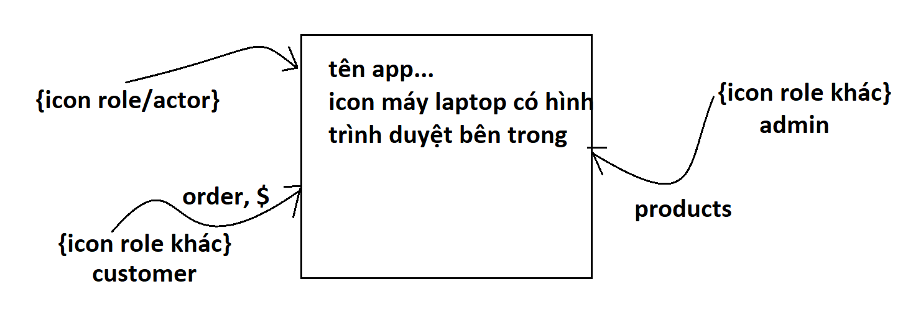

project introduction (>= 2 pages) proposed solution (2nd page) - vẽ 1 hình mô tả sơ lược về app gồm các actors/user --- luồng infor ra vào trong app

Slide 5
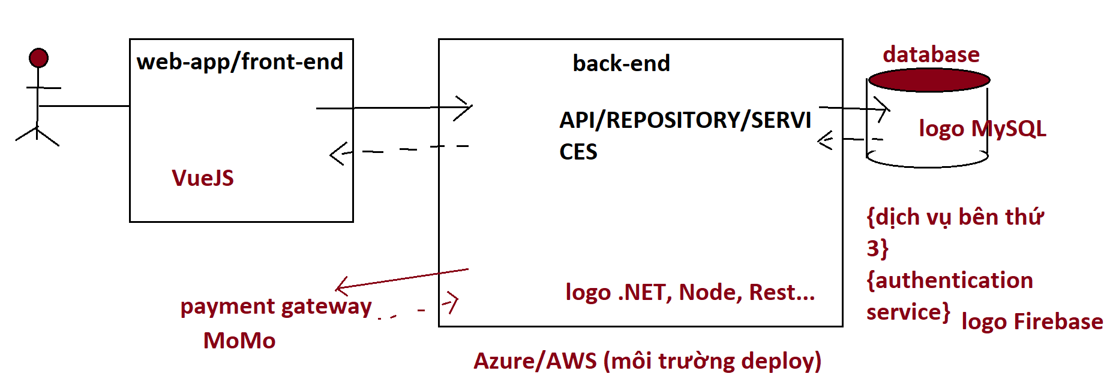
system architectural overview(2 pages)
Tech stacks
Back-end
- .NET, EF
- SpringBoot
Front-end
…
Deployement
Azure, AWS

Slide 6




features (>= 1 page)
Admin
Customer
{icon} Manage users
{icon} Manager products
{icon} Manage …
Dashboard
{icon} Manage orders
Manage cart
{icon} Manage …

Slide 7
features (>= 1 page)
Cashier
Deliver
{icon} Manage users
{icon} Manager products
{icon} Manage …
{icon} Dashboard
{icon} Manage orders
Manage cart
{icon} Manage …

Slide 8



demonstration (pages)
Scenario 1: Customer is looking for a specific product before using/ordering…
Open app
Search sp
View detail
App mình
Keyword
Product
Customer
View by category
Product list

Slide 9
demonstration (pages)
Scenario 2: Customer orders, sends ….
Open app
Search sp
View detail
App mình
Result
Product
Customer
View by category
Product list

Slide 10
outcomes (2 pages)

Slide 11
outcomes (2 pages)
App features
Customer: cart, order, pay by MoMo,…
Admin: CRUD …
Staff: Manage order, manage version of quotation…
Lessons learned
Teamwork
Cross-functional
Deadline
New techs

Slide 12
Thank you for your attention Q & A

